Slide 1

WiCare
Yen-Hua Huang
Ting-Yu Liu

Slide 2
01.
02.
Purpose
WiCare system Architecture Diagram
03.
04.
UML diagram
Work Flow
Functionality
WHY? WHAT? HOW?
Use case diagram
05.

Slide 3
01
Purpose

Slide 4

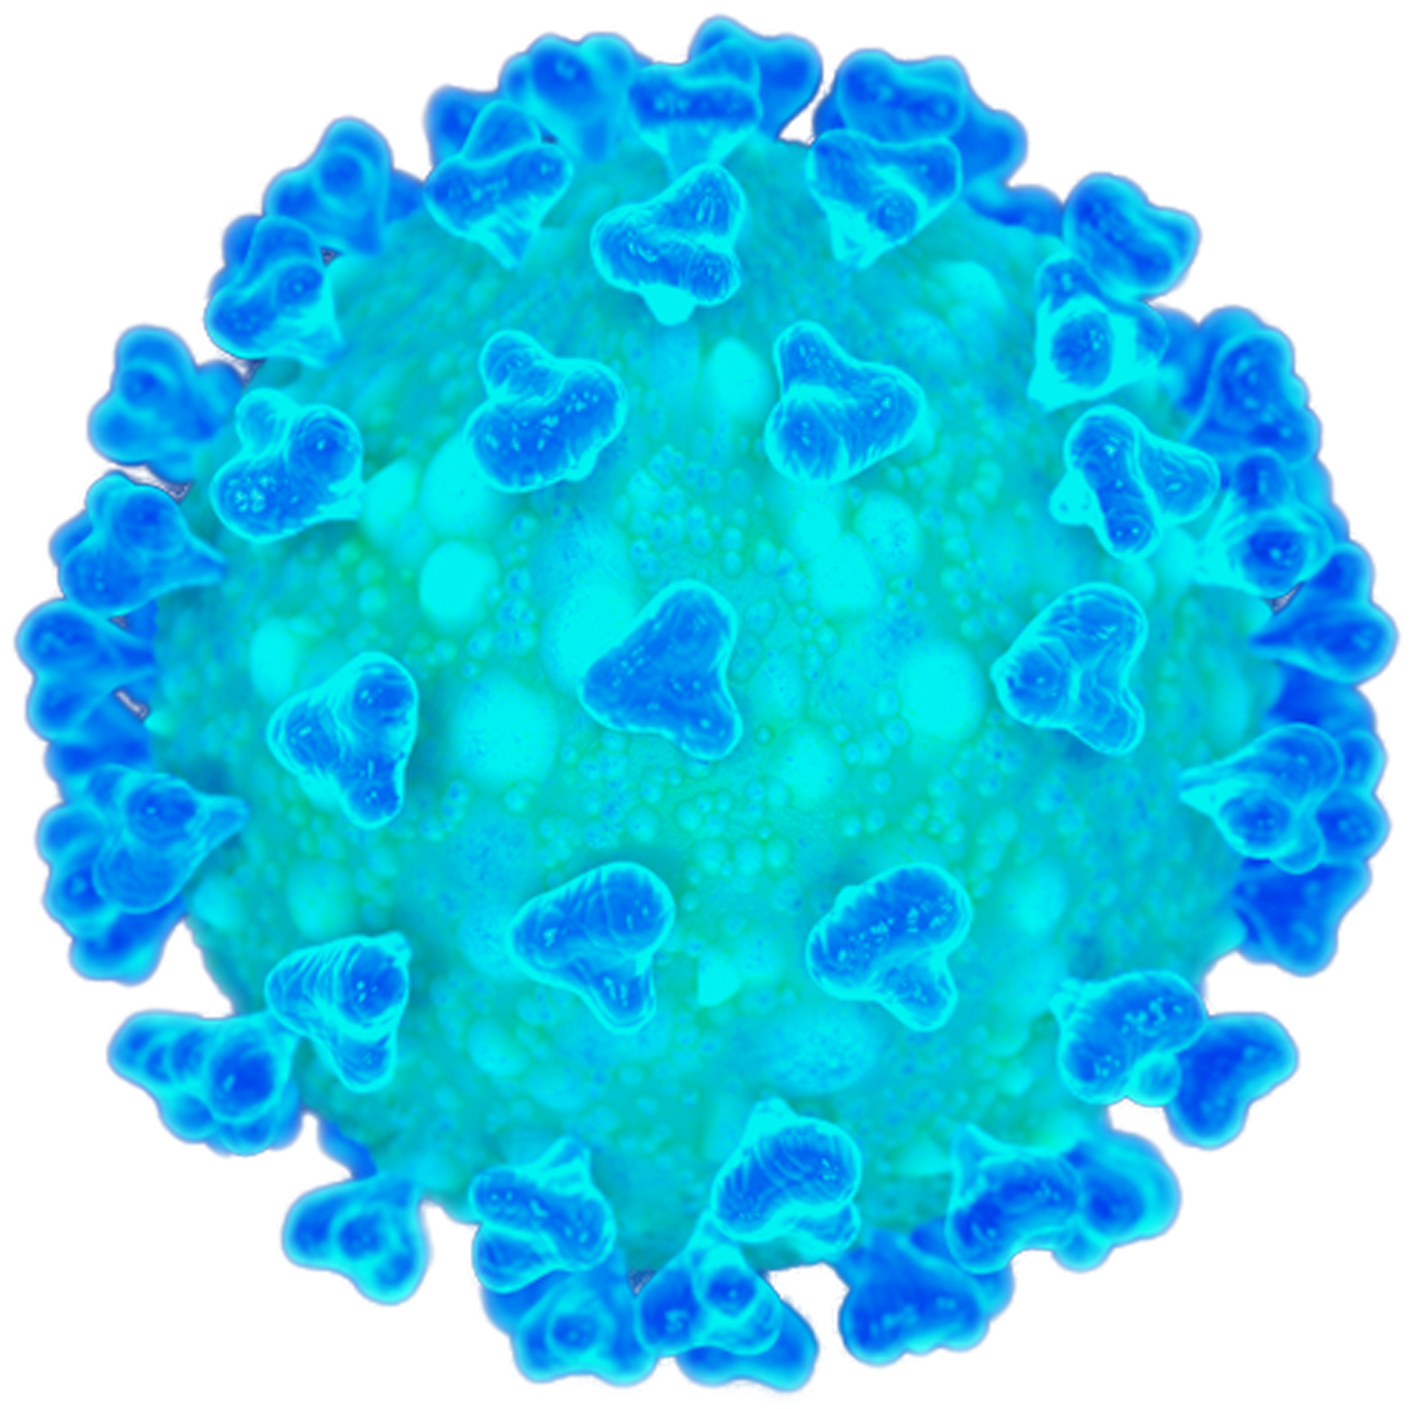
WHY?

Slide 5
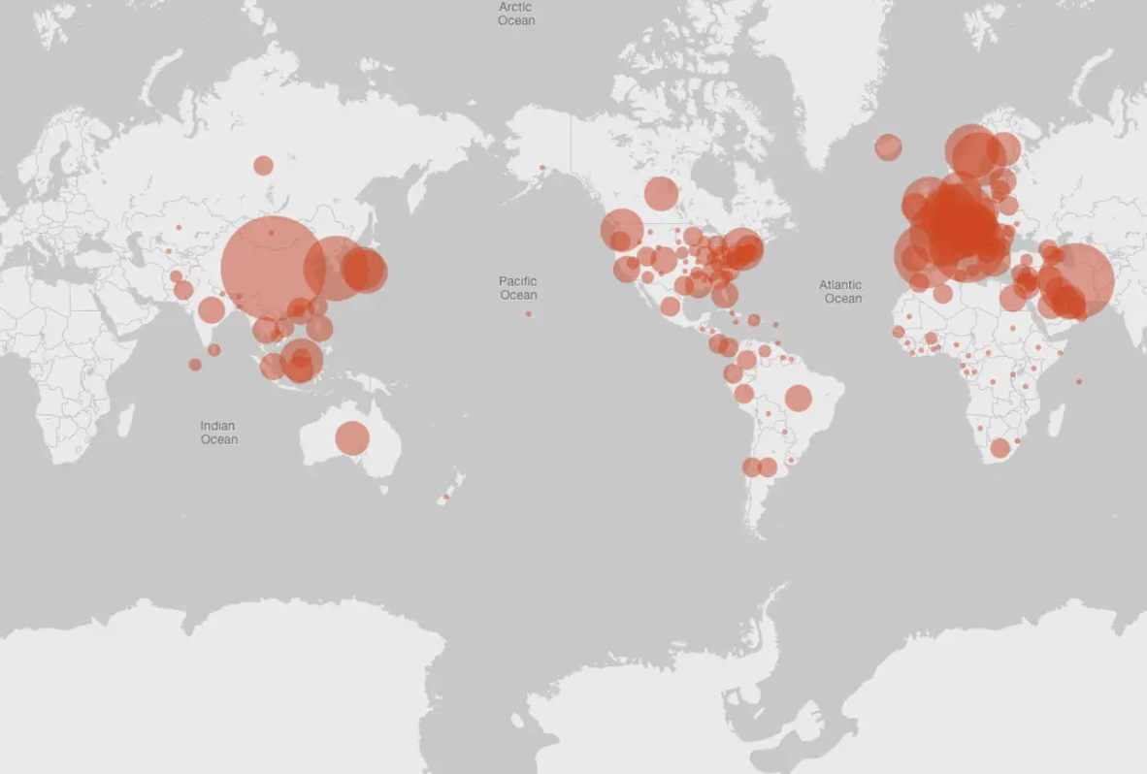

Slide 6
WHAT?

Slide 7
HOW?

Slide 8
02
WiCare system Architecture Diagram

Slide 9
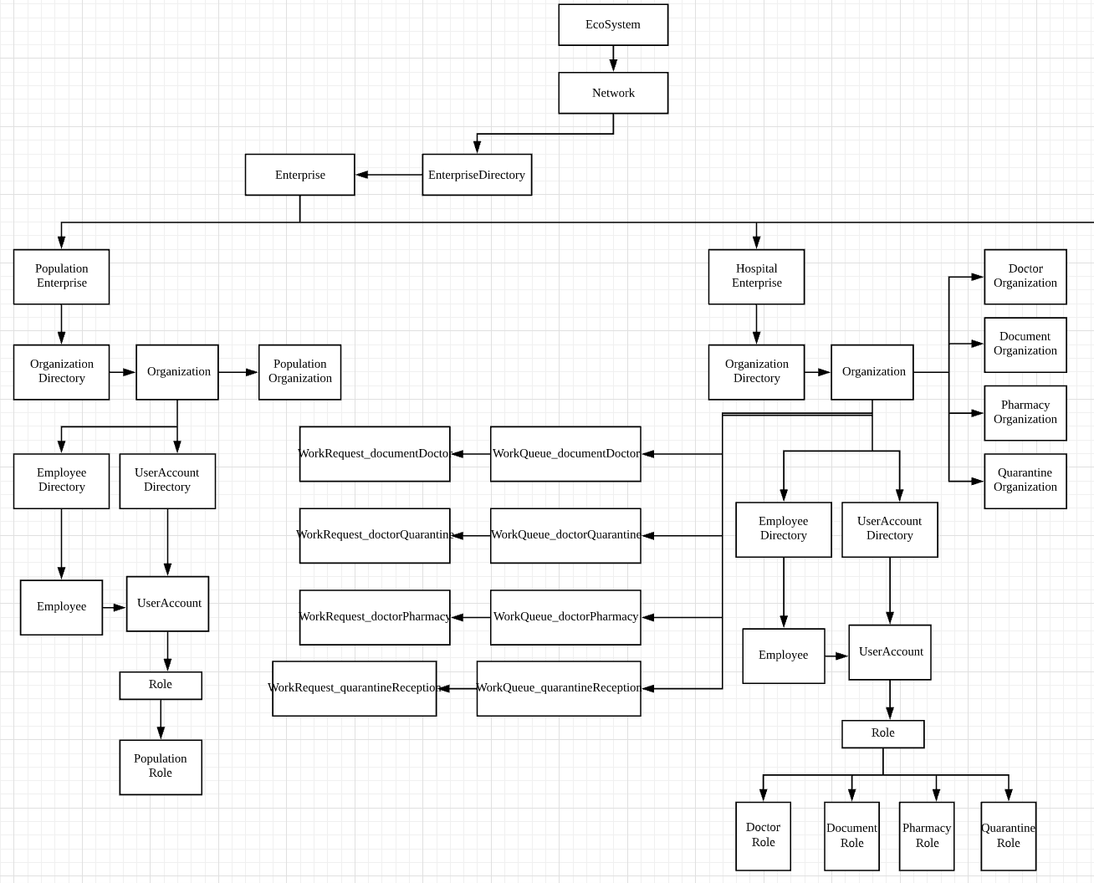

Slide 10
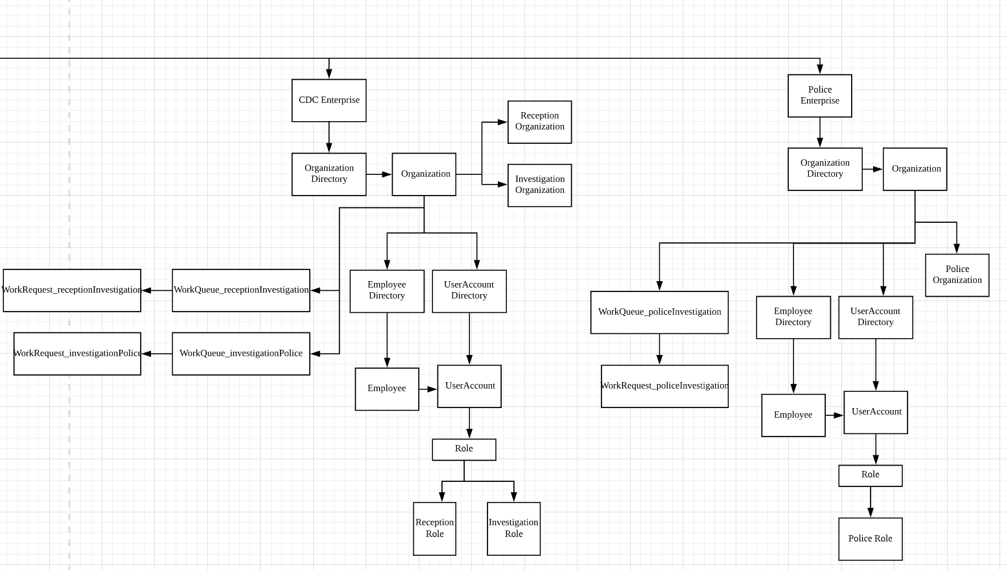

Slide 11
03
UML diagram

Slide 12
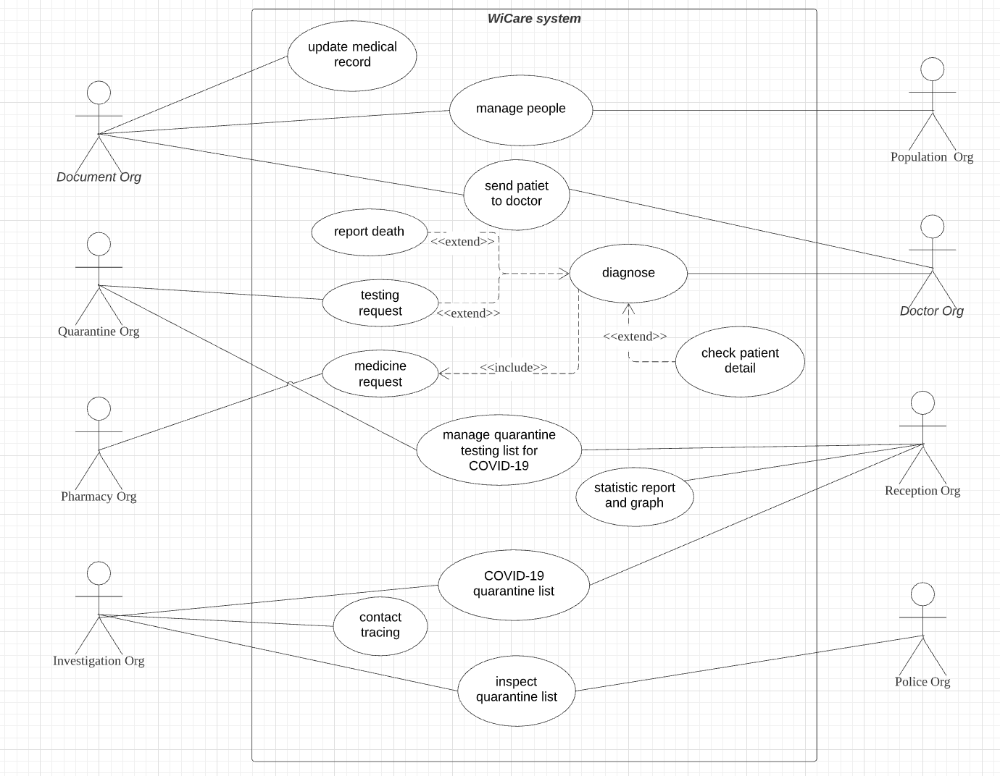

Slide 13
04
Work Flow

Slide 14








Pharmacy organization
Population organization
Document organization
Doctor organization
Quarantine organization
Police organization
Investigation organization
Reception organization

Slide 15
05
Functionality

Slide 16
Population Enterprise
Population Organization
create people into the system

Slide 17
Hospital Enterprise
Document Organization
Quarantine Organization
update/create medical record
send patient to doctor organization
receive the list of patient who are suspected for COVID-19
save testing result and update to document and CDC
Document Organization
Pharmacy Organization
manage medicine catalog and stock
manage medicine request
diagnose for patient
send test request to quarantine organization if test is needed
send medicine request to pharmacy organization
report death for patient

Slide 18
CDC Enterprise
Reception Organization
Investigation Organization
get quarantine list (people who are tested positive for COVID-19)
statistic report/graph
receive quarantine list and do contact tracing
sent the case to police organization for inspection
Constraint:
1. cannot send if the case is still on the list in police organization
2. cannot send if the case has already been sent and hasn’t process by police at the same day

Slide 19
Police Enterprise
Police Organization
Receive quarantine list from CDC and inspect every case to check if people follow stay-at-home policy
Report to CDC if the case cannot be found at their place

Slide 20
THE END

